Slide 1
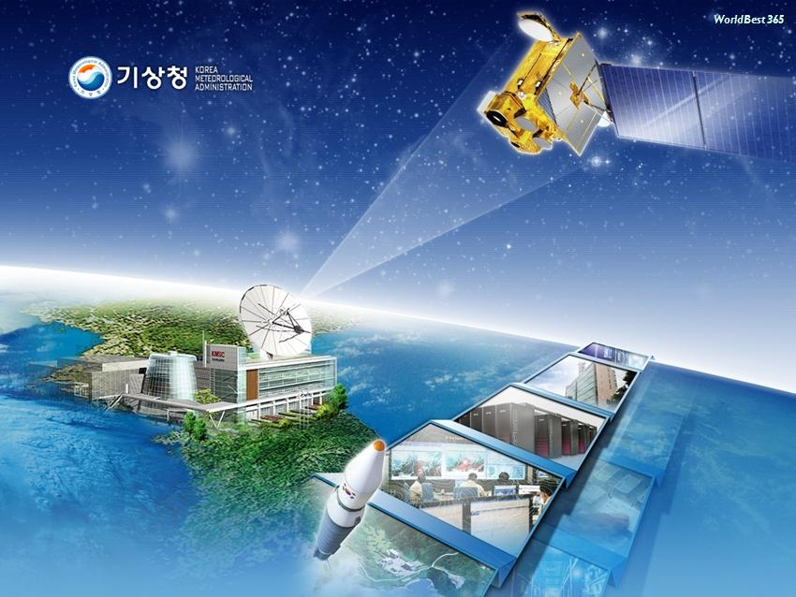
APSDEU-14/NAEDEX-26 (6th ~ 9th Oct. 2015)
KMA report on Current Status of Satellite and data assimilation activities and future plans
Hyunjong Oh (NMSC)
Changhwan Kim (NWP)

Slide 2


Contents
Satellite Activities
II. Data Assimilation Activities
III. Action Item Responses

Slide 3
Satellite Activities of KMA:
Current & Future

Slide 4
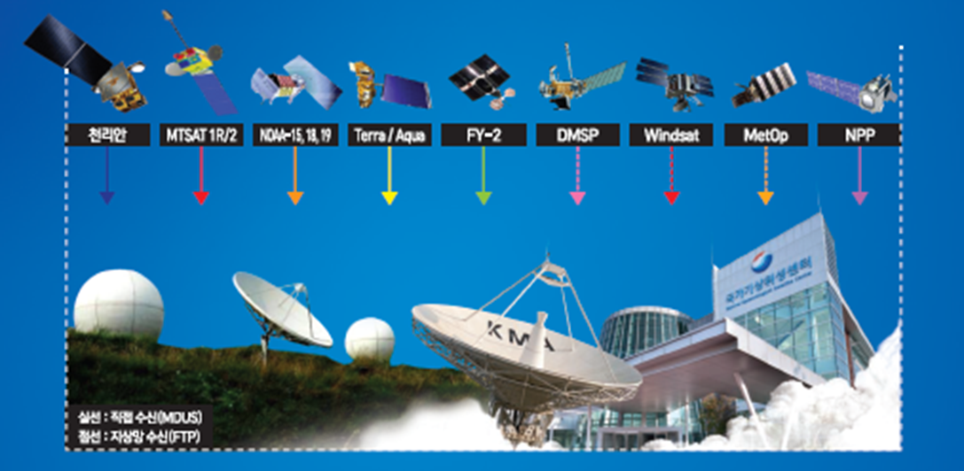
Satellite Data Received by NMSC
Method | Sat. Type | Satellite and Sensors
Direct Readout | Geo | COMS(MI), MTSAT-2 (Imager), Himawari-8(AHI) FY-2E(S-VISSR)
 | Leo | NOAA-15,18,19 (AVHRR, MHS, AMSU) Terra/Aqua (MODIS) FY-3C Metop (AVHRR, IASI) NPP(ATMS, CrIS, VIIRS)
FTP via Landline | Leo | DMSP (SSMI/S), CORIOLIS (Windsat) Metop (ASCAT), TRMM(TMI), GPM, etc.

Slide 5
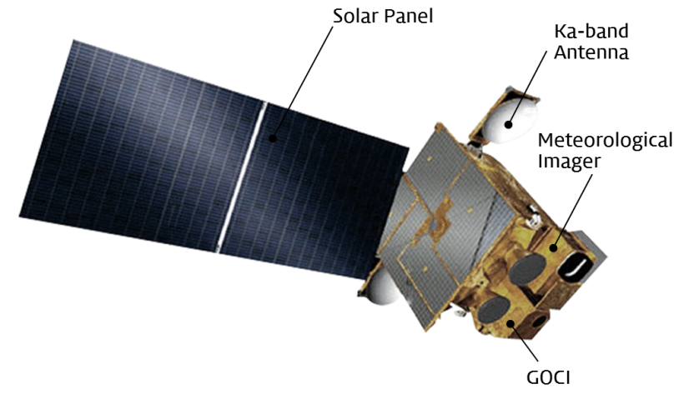
CURRENT GEO SATELLITES - COMS
COMS (Communication, Ocean, and Meteorological Satellite)
    Payloads :
    MI(5-channel VIS/IR Meteorological Imager)
    GOCI(Geostationary Ocean Color Imager)
    Launch : 26/06/2010
    Orbit : 128.2°E
    Lifetime estimated : 2011 - 2018
    Operator : KMA, KIOST, ETRI
COMS MI data Service via Satellite
Broadcast to M/SDUSs(Medium/Small-scale Data Utilization Stations)
Format : H/LRIT(High/Low Rate Information Transmission)
Service via Landline
[Website] KMA/NMSC Homepage, DCPC-NMSC (open to registered users)
[FTP] Access to NMSC FTP server (open to organization with MOU)
Notes:
COMS has been operating since 2011 by KMA and KIOST. The estimated end of life of COMS is 2018.
The observed data by MI is reprocessed by ground station and disseminated using two kinds of transmission methods, direct broadcasting via satellite and indirect service via landline.
For direct broadcast via satellite, COMS data are usable for MDUS, SDUS with the two types of data formats, HRIT for MDUS and LRIT for SDUS.
In service via landeline, for internal and cooperation organization, intranet, comprehensive WIS, and disaster prevention WIS are used. The users in general public and expert group receive the data from KMA homepage and NMSC hompage, ftp, respectively.

Slide 6
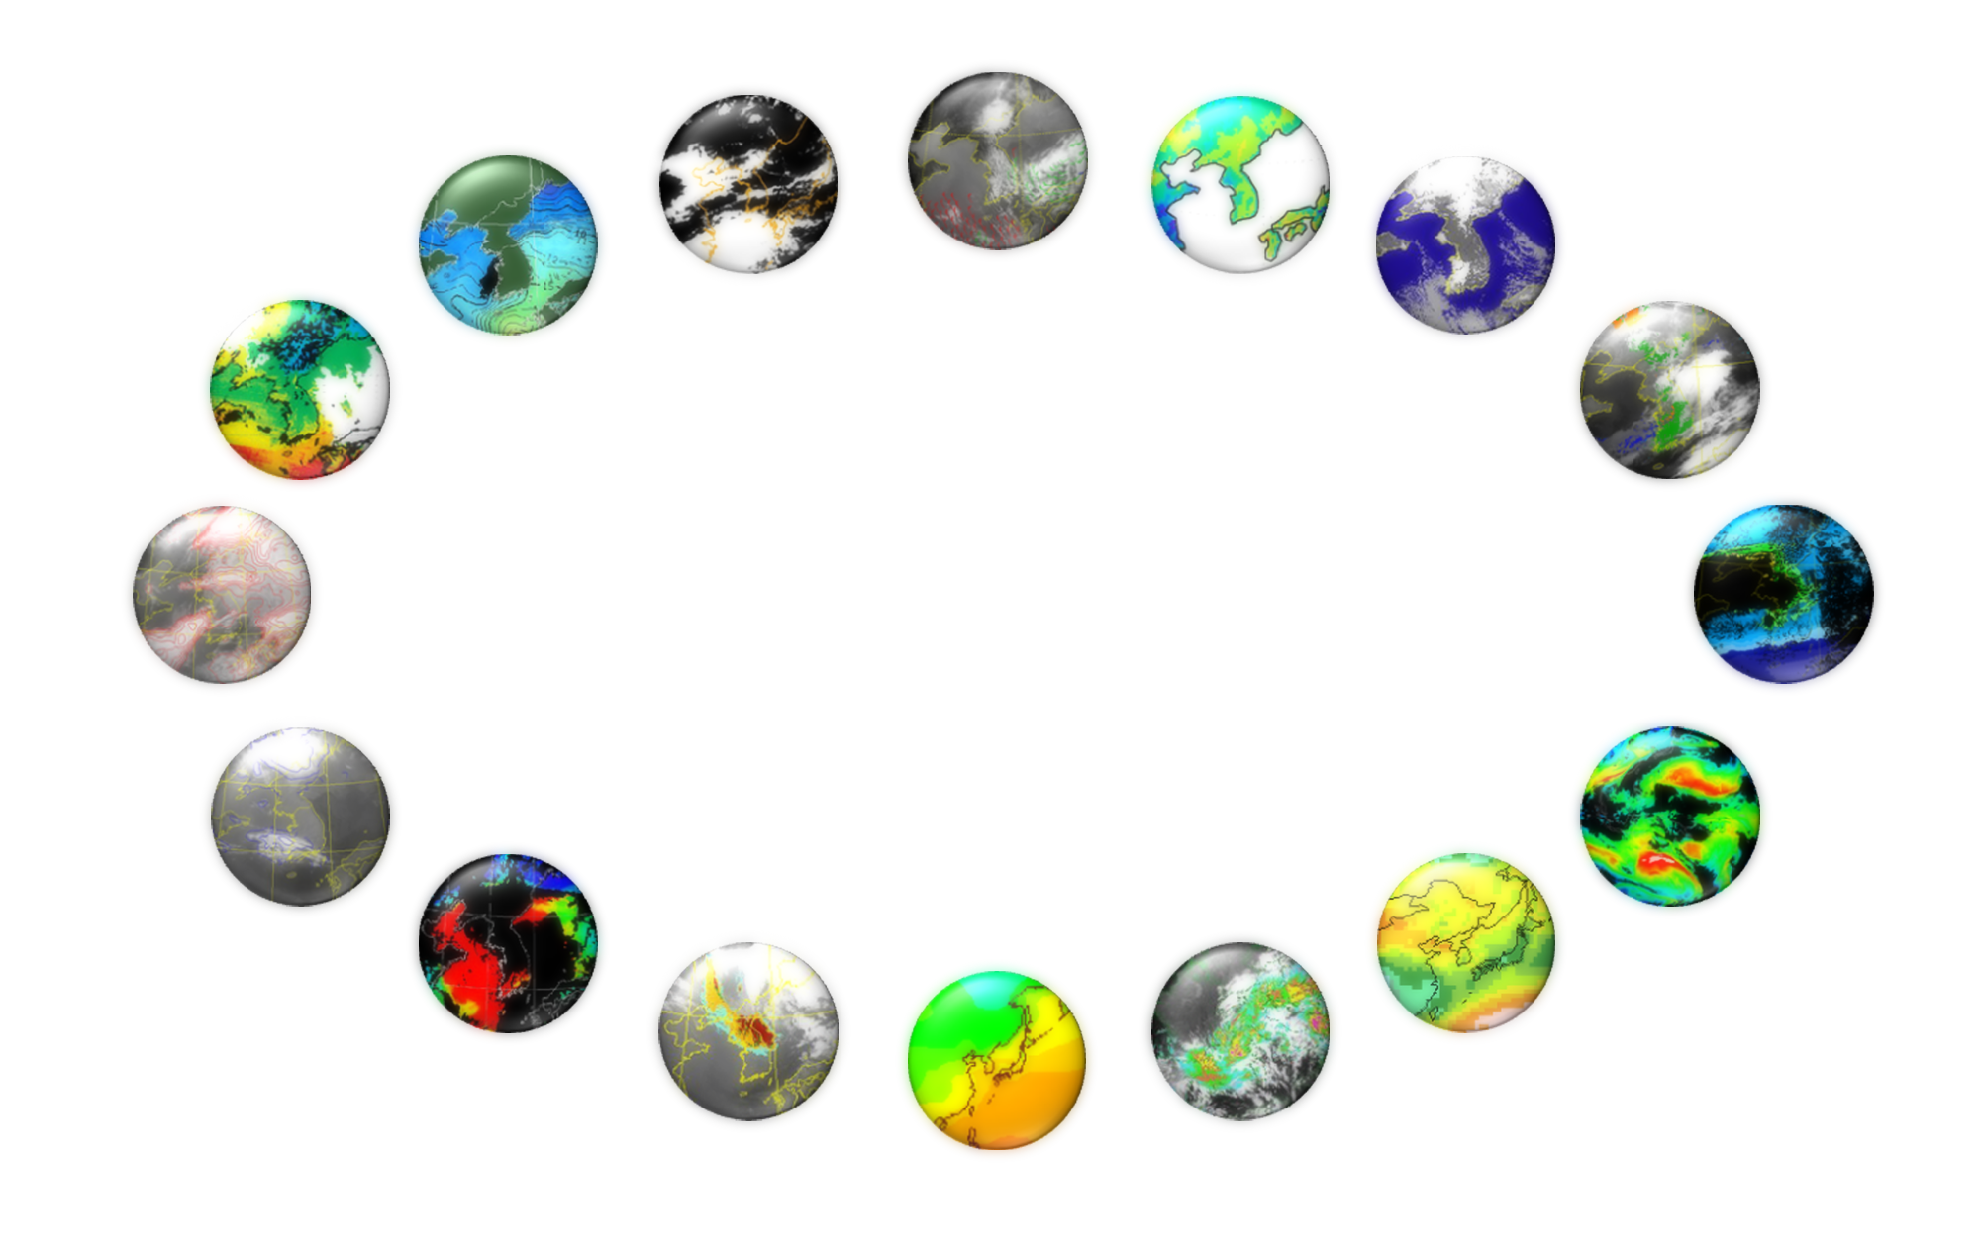
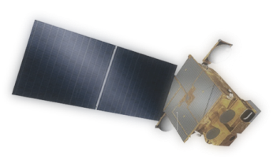
16 baseline products from Meteorological Imager
CLD
(Cloud Detection)
AMV
(Atmospheric Motion Vector)
LST
(Land Surface Temperature)
SST
(Sea Surface Temperature)
SSI
(Sea Ice/Snow)
TPW
(Total Precipitable Water)
Fog
CTT/CTH
(Cloud Top Temperature/Height)
UTH
(Upper Tropospheric Humidity)
COMS
CA
(Cloud Analysis)
CSR
(Clear Sky Radiance)
AOD
(Aerosol Optical Depth)
INS
(Insolation)
AI
(Aerosol Index)
OLR
(Outgoing Longwave Radiation)
RI
(Rain Intensity)
Slide: 6
Notes:
There are 16 baseline products from COMS Meteorological Data Processing System.
One of the advanced feature of CMDPS is that CMDPS has its own validation system. With this, NMSC can update the algorithm from the validation results to provide with more accurate products to users.

Slide 7
CURRENT GEO SATELLITES - COMS
Geostationary Ocean Color Imager (GOCI)
GSD(Ground Sampling Distance) : 500m × 500m
Target Area : 2,500km × 2,500km(Center : 130E 36N)
Included Nations : Korea, China, Japan, Russia, etc.
Temporal Resolution : 1hour (8 times at 1 day)
GOCI data distribution
Scientific user : http://kosc.kordi.re.kr/processingsoftware/gdps/onlinehelp.kosc
Domestic gov./inst. User : ftp
Public user : portal site
http://map.naver.com (in korean)
Service : L1B RGB, CHL, CDOM, SS Jpeg image(only)
International scientific user : redistribution site
Approved by GOCI operation committee(Jan. 2013)
Notes:
GOCI has been developed to provide a monitoring of ocean colour around the Korean Peninsula to detect, monitor, quantify, and predict short term changes of coastal ocean environment for marine science research and application purpose.
GOCI has 500m×500m pixel resolution (GSD) and a coverage area of 2,500km×2,500km covering Korea, Japan, the eastern coast of China, GOCI can acquire 16 slot images and compose one complete image.
and GOCI receives images eight times a day in hourly intervals from 00:15 UTC to 07:45 UTC.

Slide 8
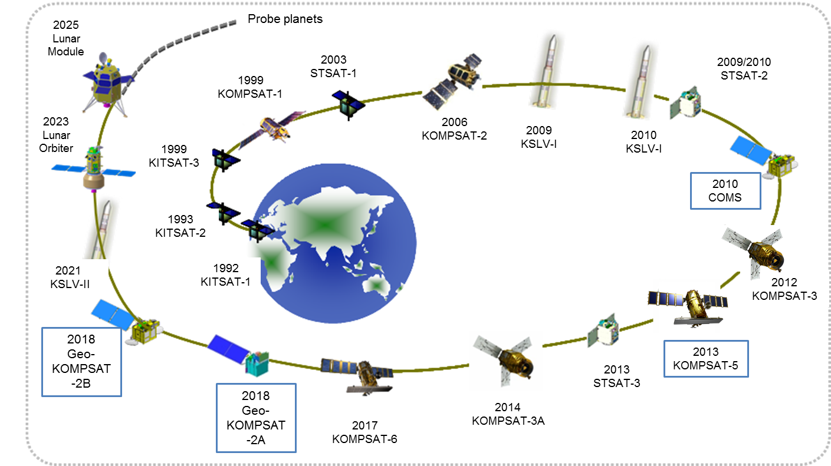
Development of the GEO-KOMPSAT-2
National-Space-Development-Plan
Notes:
This is the national space development plan of Korea.
In 2010, COMS was launched, KOMPSAT-5 with GPSRO was launched in Aug. 2013.
The GEO-KOMPSAT-2A and GEO-KOMPSAT-2B is scheduled to be launched in 2018.

Slide 9
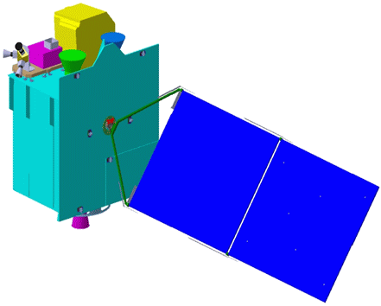
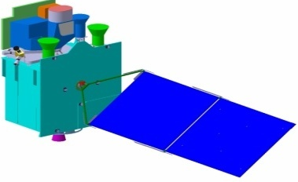
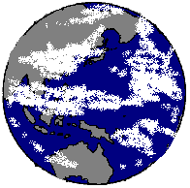

Geo-KOMPSAT-2 Program
GK-2A for the next generation Meteorological Imager and SW monitoring
GK-2B for the Ocean Color and Atmospheric Trace Gas monitoring
KMA
Meteorological Sensor
Space weather Sensor
Geo-KOMPSAT-2B
Geo-KOMPSAT-2A
Ocean /
Environmental Sensor
  2018 ~ 2028 (10 years)
Ground Segment
Data Processing System
9
Notes:
The schematic diagram is brief introduction of development of GEO-KOMPSAT-2 program in Korea.
Differently from COMS, two separated satellites are developing. One is for meteorological mission only named GEO-KOMPSAT-2A, and the other is for ocean and environmental mission named GEOKOMPSAT-2B.
As for sub-payload of GEO-KOMPSAT-2A, KMA is developing the space weather sensor for developing the space weather monitoring system by observing the solar activities.
The program of the development of ground segment and data processing system will be kicked off in 2014. And the preliminary study has been started in 2011 and is extended to the end of this year.

Slide 10
Future satellite system – Geo-KOMPSAT-2
Sector | Satellite in Orbit | Operator | Location | Launch date | Environmental payload and status
West Pacific | COMS | KMA, KIOST | 128.2°E | 26/06/2010 | 5-channel VIS/IR Meteorological Imager (MI), Geost. Ocean Colour Imager (GOCI) Direct Broadcast via HRIT/LRIT
 | GEO-KOMPSAT-2A | KMA | 128.2°E | 05/2018 | Advanced Meteorological Imager (AMI), Space Environmental monitoring payload Direct broadcast of AMI data via UHRIT/HRIT/LRIT
 | GEO-KOMPSAT-2B | MOF(Ministry of Ocean and Fisheries), ME(Ministry of Environment) | 128.0°E | 12/2018 | Advanced Geostationary Ocean Colour Imager(GOCI-II), Geostationary Environmental Monitoring Spectrometer(GEMS)
Notes:
KMA is currently operating geostationary satellite COMS for the weather forecasting.
The COMS follow-on satellites are consist of two satellites, GEO-KOMPSAT-2A and GEO-KOMPSAT-2B.
GEO-KOMPSAT-2A will succeed meteorological mission through the 16 channel meteorological instrument AMI. In addition to AMI, GEO-KOMPSAT-2A will have the space environmental instrument.
GEO-KOMPSAT-2B will be loading two instruments. One is ocean colour imager GOCI-II, and the other is environmental monitoring spectrometer GEMS.
GEO-KOMPSAT-2A is scheduled be launched in the second quarter of 2018 before the end of the COMS design life. And, GEO-KOMPSAT-2B will be launched in the end of 2018.
The both of GEO-KOMPSAT-2A and GEO-KOMPSAT-2B will be operated for 10 years.

Slide 11
Payload of GK-2A : AMI
Observation mission(GEO-KOMPSAT-2A)
Advanced Meteorological Imager (AMI)
Multi-channel capacity: 16 channels
Temporal resolution: within 10 minutes for Full Disk observation
Observation Flexibility for the regional area selection and scheduling
Lifetime of meteorological mission: 10 years
Bands |  | Center Wavelength |  | Band Width (Max, um) | Resolution (km)
 |  | Min(um) | Max(um)
VNIR | VIS0.4 | 0.431 | 0.479 | 0.075 | 1
 | VIS0.5 | 0.5025 | 0.5175 | 0.0625 | 1
 | VIS0.6 | 0.625 | 0.66 | 0.125 | 0.5
 | VIS0.8 | 0.8495 | 0.8705 | 0.0875 | 1
 | NIR1.3 | 1.373 | 1.383 | 0.03 | 2
 | NIR1.6 | 1.601 | 1.619 | 0.075 | 2
MWIR | IR3.8 | 3.74 | 3.96 | 0.5 | 2
 | IR6.3 | 6.061 | 6.425 | 1.038 | 2
 | IR6.9 | 6.89 | 7.01 | 0.5 | 2
 | IR7.3 | 7.258 | 7.433 | 0.688 | 2
 | IR8.7 | 8.44 | 8.76 | 0.5 | 2
Bands |  | Center Wavelength |  | Band Width (Max, um) | Resolution (km)
 |  | Min(um) | Max(um)
LWIR | IR9.6 | 9.543 | 9.717 | 0.475 | 2
 | IR10.5 | 10.25 | 10.61 | 0.875 | 2
 | IR11.2 | 11.08 | 11.32 | 1.0 | 2
 | IR12.3 | 12.15 | 12.45 | 1.25 | 2
 | IR13.3 | 13.21 | 13.39 | 0.75 | 2
Notes:
Advanced Meteorological Imager AMI of GEO-KOMPSAT-2A is comparable to those of the ABI and AHI imager on board Himawari-8/9 and GOES-R.
The detailed specification of AMI are listed on the table
Full Disk observation time is within 10 minutes. There are flexibility for the regional area selection and scheduling.
KMA plans to broadcast all 16 channels data while maintaining L/HRIT broadcast corresponding to five channels

Slide 12
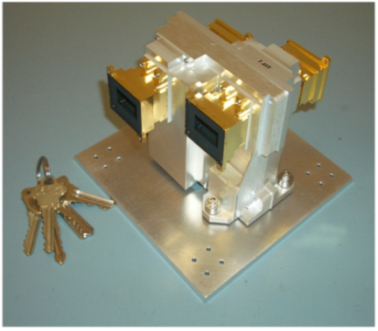
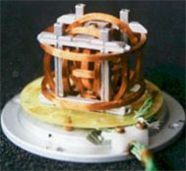
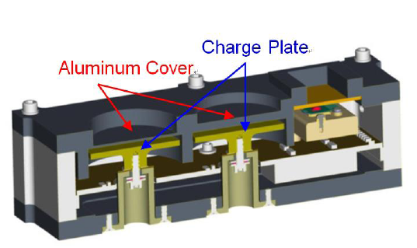
KSEM (Korean Space Environmental Monitor)
KSEM specification
Sensor Unit | Measurement Range | Accuracy | Time Resolution | Remark
PD | 100KeV ~ 2MeV | <30%(ΔE/E) | 0.33s | 6 measurement direction
MG | -350nT ~ +350nT | <1nT | <0.1s | Boom type
CM | -3pA/cm² ~+3pA/cm² | <0.01 pA/cm² | < 1s | -
Particle detector (3ea)
Magnetic field sensor(2ea)
Charging Monitor(1ea)
12

Slide 13
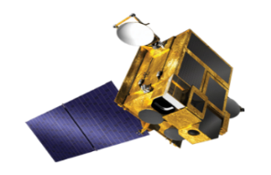
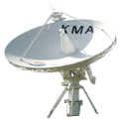






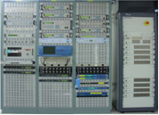


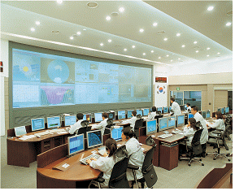














GK-2A GSD : Configuration
MSGS
(at NMSC)
LRIT/HRIT/UHRIT
RF
RF
RF
RF
RF
RF
Command/
Telemetry
RF
RF
LRIT/HRIT/UHRIT
BB
BB
BB
BB
LRIT/HRIT/UHRIT
BB
BB
BB
BB
Common Test Bed
Reception and Processing
Satellite Control
Reception and Processing
Raw Data
Raw Data
Algorithm Optimization
Pre-processing
RF/BB
Pre-processing
Level 1A/1B
DB
DB
Level 1A/1B
Off-line Simulator
Level 2/3
Level 2/3
Processing/Analysis
Processing/Analysis
System Validation
Level 0/1A/1B/2/3
Data Mgmt. and Service
Foreign Satellite Data
Data Mgmt. and Service
Foreign Sat.
Level 0/1A/1B/2/3, Foreign Satellite Data
Level 1B
Users

Slide 14
GK-2A GSD : Meteorological products (52)
Scene & Surface Analysis (13) | Cloud & Precipitation (14) | Aerosol & Radiation (14) | Atmospheric condition & Aviation (11)
Cloud detection | Cloud Top Temperature | Aerosol Detection | Atmospheric Motion Vector
Snow Cover | Cloud Top Pressure | Aerosol Optical Depth | Vertical Temperature Profile
Sea Ice Cover | Cloud Top Height | Asian Dust Detection | Vertical Moisture Profile
Fog | Cloud Type | Asian Dust Optical Depth | Stability Index
Sea Surface Temperature | Cloud Phase | Aerosol Particle Size | Total Precipitable Water
Land Surface Temperature | Cloud Amount | Volcanic Ash Detection and Height | Tropopause Folding Turbulence
Surface Emissivity | Cloud Optical Depth | Visibility | Total Ozone
Surface Albedo | Cloud Effective Radius | Radiances | SO₂ Detection
Fire Detection | Cloud Liquid Water Path | Downward SW Radiation (SFC) | Convective Initiation
Vegetation Index | Cloud Ice Water Path | Reflected SW Radiation (TOA) | Overshooting Top Detection
Vegetation Green Fraction | Cloud Layer/Height | Absorbed SW Radiation (SFC) | Aircraft Icing
Snow Depth | Rainfall Rate | Upward LW Radiation (TOA)
Current | Rainfall Potential | Downward LW Radiation (SFC)
 | Probability of Rainfall | Upward LW Radiation (SFC)

Slide 15
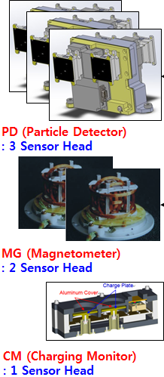
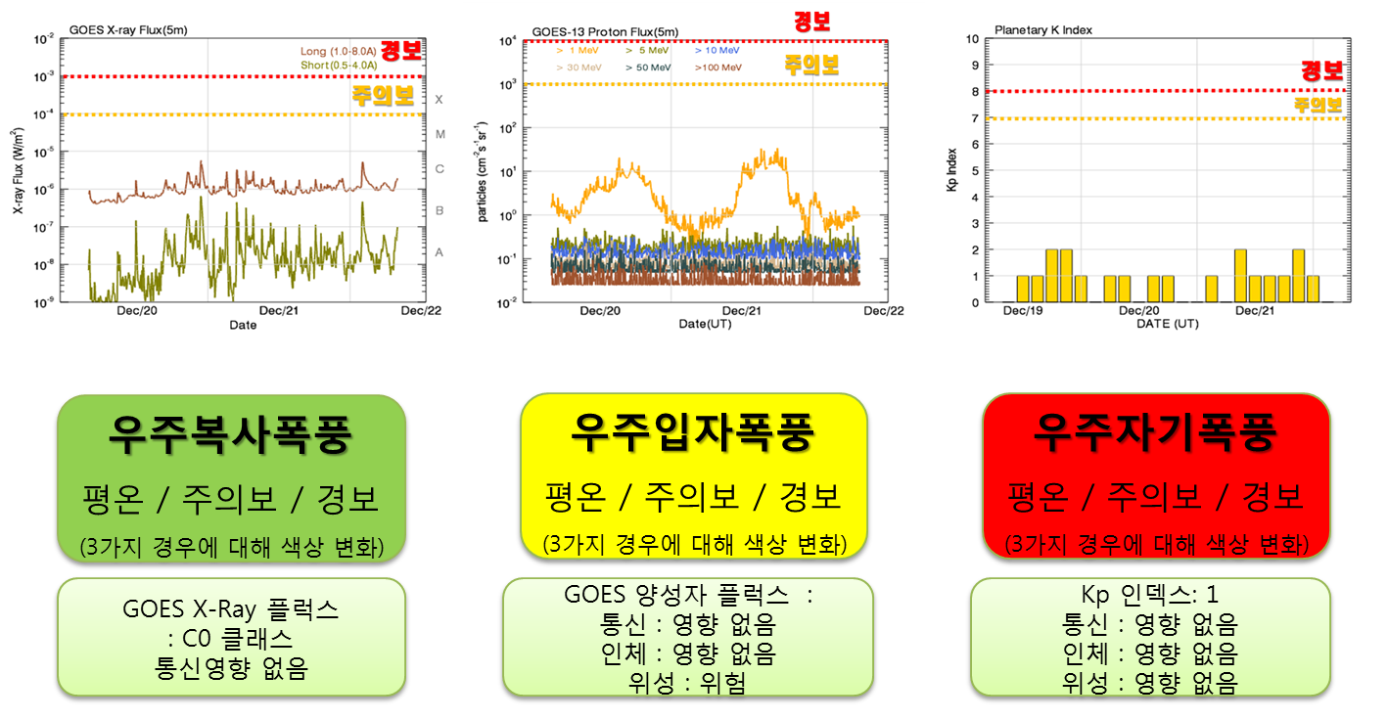
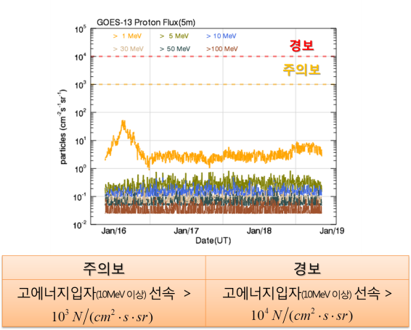
GK-2A GSD : Space weather data processing
  Korea Space Environment Monitor(KSEM)
    Measurement of electron on mid energy range and magnetic field
Support for stable operation of GEO-KOMPSAT-2A
Observation
Products (5)
Real-time high energy particle distribution over the radiation belt
3D particle distribution /prediction
Deep dielectric charging prediction index
2 Geomagnetic storm indices
Differential energy flux of electron and ion
Near Earth magnetic field
Satellite internal charging current
15
Notes:
Korea Space Environment Monitor(KSEM) loaded in GEO-KOMPSAT-2A
measures the electron flux on mid-level energy range, magnetic field
and the charging current due to high energy particles for space weather
and to support for stable operation of GEO-KOMPSAT-2A.
KMA will develop the 5 more products in the area of space weather in addition to 52 meteorological products.

Slide 16
Data Service Plan of GK-2A
[Via GK-2A broadcast]
Broadcast all 16 channels data (UHRIT) of meteorological observations
Maintain L/HRIT broadcast corresponding to COMS five channels
GOCI-II products might be broadcast via HRIT (TBC)
[Via Landline]
Web-based service system will be renovated for GK-2A data
GK-2A data also will be available in DCPC-NMSC (http://dcpc.nmsc.kma.go.kr)
Categories | UHRIT | COMS-like H/LRIT
 |  | HRIT | LRIT
Service
Data Rate | < 31 Mbps | 3 Mbps | ~512 Kbps
Frequencies | Uplink : S-band Downlink : X-band | Uplink : S-band , Downlink : L-band * Same Frequencies band with COMS
Data Contents | AMI Image(16 Ch.) Alphanumeric text Encryption Key Message | AMI Image(5 Ch.) Alphanumeric text Encryption Key Message GOCI-II products(TBC) | AMI Image (5 Ch.) Alphanumeric text Encryption Key Message Lv2 products GOCI-II image file
Mode | FD, ENH | FD, ENH | FD, ENH
Station | LDUS | MDUS | SDUS

Slide 17



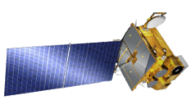
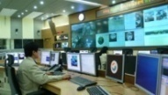

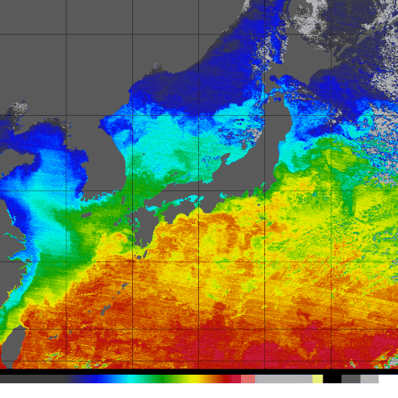
GK-2A GSD : Milestone
Satellite bus design
and Review
Integrate
Module
Satellite system
integration
Launch/IOT/Operation
PAYLOAD & sATELLITE
Satellite
operation
Analysis of
system
requirements
Preliminary
design
Critical design
Instrument
Integration
and test
System
Integration
and test
Prepare
To
launch
launch / IOT
Start
SRR
PDR
CDR (Sep. 2015)
Environmental Test
Delivery
Launch
TRR
2013
2014
2015
2016
2017
2018
2019
Operation/utilization /service
Kick-off (Jul. 2014)
Requirement
Analysis
Preliminary
design
Critical
design
Implementation
/verification
Integration test
/Optimization
In Orbit Test
GROUND SYSTEM
Development
Phase 1
System Design/
Algorithm Dev.
Phase 2
Implementation/
Verification
Phase 3
Integration Test/
IOT of GS
17

Slide 18
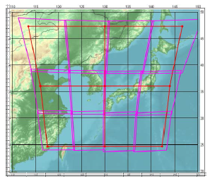

Payload of GK-2B : GOCI-II
GOCI-II(Geostationary Ocean Colour Imager-II)
The succession and expansion of the mission of GOCI
Supporting user-definable observation requests such as clear sky area without clouds and special-event areas, etc
10 times daily regional and 1 time daily global observation
Higher spatial resolution, 250m×250m(at Eq), and 12 spectral bands
Items | GOCI Specs | GOCI-II Specs
Bus | COMS | GEO-KOMPSAT-2B
Increased band number | 8 bands (412~865 nm) | 12 bands (380 ~ 865nm)
Improved spatial resolution | 500m | 250m (at 130E, Eq)
More observations | 8 times/day | 10 times/day
Pointable & Full Disk coverage | Local Area | Local Area + Full Disk
LA
FD
Notes:
The aim of GOCI-II is the succession and expansion of the mission of GOCI and supporting user-definable observation requests such as clear sky area without clouds and special-event areas, etc.
GOCI-II is expected to have largely enhanced radiometric/geometric performance in comparison with GOCI.
- 12 bands
- 10 times daily regional and 1 time daily global observation
- higher spatial resolution, 250m×250m, and 12 spectral bands

Slide 19
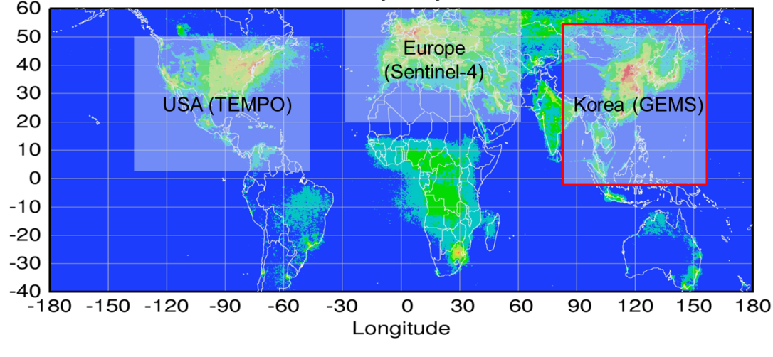
Payload of GK-2B : GEMS
GEMS(Geostationary Environmental Monitoring Spectrometer, GEO-KOMPSAT-2B)
Contributing to Atmospheric Composition Constellation under the Committee on Earth Observation Satellites (CEOS)
understanding of the globalization of pollution events, source/sink identification, and long-range transport of pollutants and short-lived climate forcers (SLCFs)
baseline : Korea (GEMS), Europe (Sentinel-4), and the US (TEMPO)
Bus | GEO-KOMPSAT-2B
Payload | Scanning UV-Visible(300-500 nm) Spectrometer
Measurement | O3, NO2, SO2, HCHO, Aerosols
Duty cycle/Imaging time | 8 images during daytime (30 min imaging + 30 min rest) × 8 times/day
Field of regard | > 5,000 km(N/S) × 5,000 km(E/W) N/S: 45°N～5°S, E/W: Selectable between 75°E～145°E
Notes:
Ministry of Environment (ME), Korea, is developing the Geostationary Environmental Monitoring Spectrometer (GEMS) for atmospheric composition measurements in the Asia-Pacific region.
GEMS will contribute to the understanding of the globalization of pollution events, source/sink identification, and long-range transport of pollutants and short-lived climate forcers (SLCFs), as a part of the activities of Atmospheric Composition Constellation with Sentinel-4 of Europe and TEMPO of US.
under the Committee on Earth Observation Satellites (CEOS).
This Constellation coordination activity is focused on collaboration to improve and extend data utilization from the planned missions. The missions now funded are: Korea (GEMS), Europe (Sentinel-4), and the US (TEMPO) will enable the “baseline” constellation data products.

Slide 20
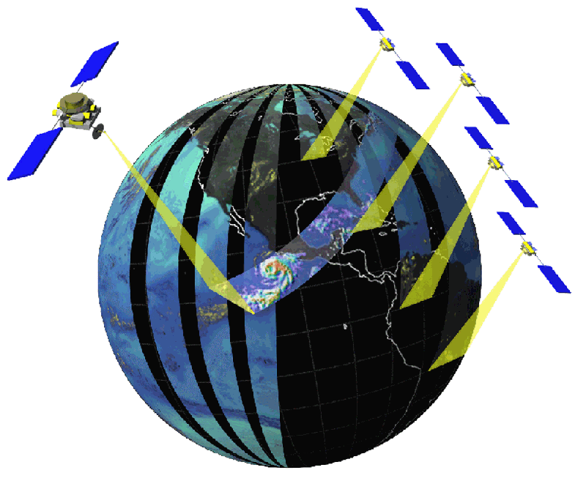
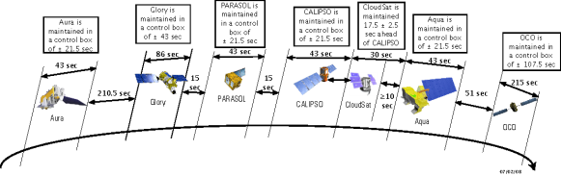


LEO Development Plan
Generating numerical model input data
(Cloud, land surface, Ocean, Construction of Atmosphere data)
Improve weather forecast accuracy
Standard monitoring of severe weather
Water control for preparing disaster
Understanding climate change
Managing future water resources
Preparing future climate
Advanced weather observation-contribution to international society, international cooperations
Observation in all-weather conditions
Monitoring Climate change factor
(sea ice, stratospheric and tropospheric temperature, water cycle factor)
LEO satellite operation
International Program
(ATMS, CrIS, GMI etc)
Standard observation of weather factor
(heavy rain, typhoon precipitation, snow cover, strong wind)
Mutual complement
Synergy effect
GEO + LEO satellite joint operation system

Slide 21
LEO Development Plan
Generic technology research
- LEO meteorological satellite instruments technology research
- LEO meteorological satellite development mid-long term roadmap
- International technology development cooperation research
Plan research
2012-13
Secure
a budget
2015-2016
Secure a budget for LEO satellite
- Political and technical validity
- Economical validity and analysis of benefits
- Surveying industrial ripple effects and proposing the way of improving manpower
Development of the LEO meteorological satellite
- Developing instruments of the LEO satellite
- Satellite bus, system integration and developing testing technique
- Ground segments development and secure a image quality technique
Satellite
development
2017-
Launch
/Utilization
2022-
Application of data Utilization plan
- Apply to weather, climate, earthquake, volcano, disaster, etc.
- Data utilization research for global water/climate, etc.
- Supply standard input data of numerical model
21
Notes:
From the planning research in 2012, LEO meteorological satellite is scheduled to develop from 2015 to 2020.
But the timeline will be flexible.

Slide 22
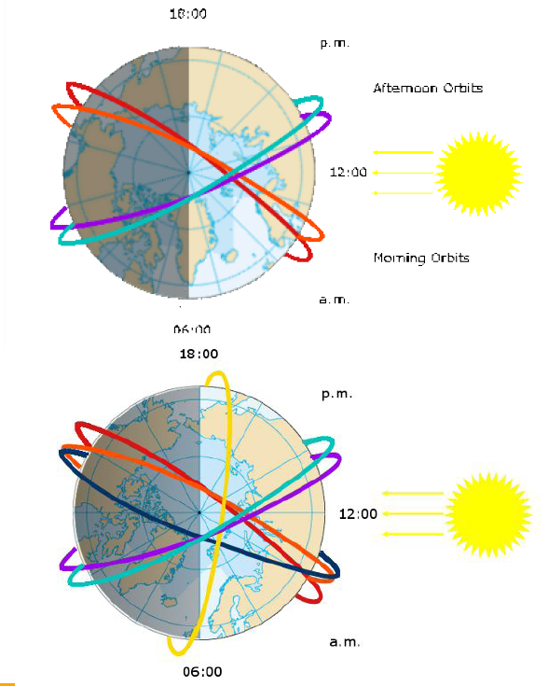
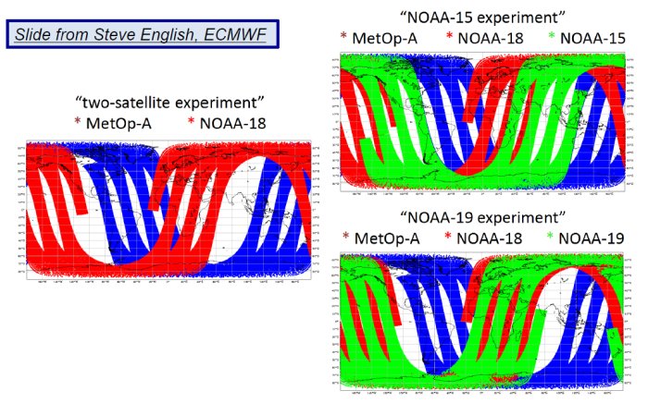
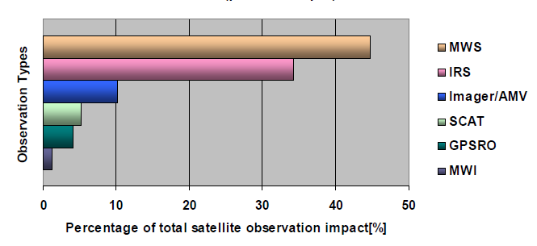
Feasibility Study for LEO Development (2015)
Which orbit mission, which payload can give us the biggest benefits?
GMI
ATMS
CrIS
GPM MW Imager (150kg)
10.65(V,H), 18.7(V,H), 23.8(V), 36.5(V,H), 89(V,H), 166(V,H), 183(V)
885 km
Inclination 65˚ (3 hourly Global obs.)
1.2 m
MW Sounder (85kg)
22 bands (23~183 GHz)
15.8km@36.5GHz(Ref. Freq.)
약2,200km
전구 2회/일
S-NPP / JPSS1, 2 planned
Hyperspectral IR Sounder (143kg)
1305 channels(μm) (3.92~4.64, 5.71~8.26, 9.14~15.38)
13.6 km
2,200km
전구 2회/일
S-NPP / JPSS1, 2 planned

Slide 23
NWP Activities of KMA:
Current & Future

Slide 24

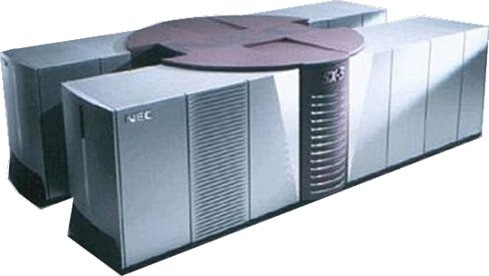






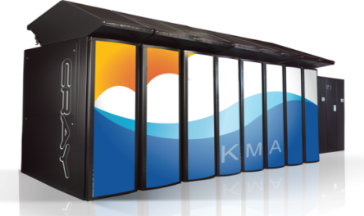
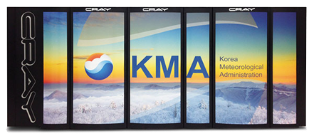
Super Computer
NEC SX-5/28M2
1999.12 ~ 2005.11
1st Supercomputer
Theoretical performance
0.2 TFlops
CRAY X1E 1024/MSP
2005.12 ~ 2010.11
2nd Supercomputer
×90
Theoretical performance
18.5 TFlops
CRAY XE6 90,240 cores
2010.12 ~
3rd Supercomputer
×41
Theoretical performance
758 TFlops
CRAY XC40 139,932 cores
2015.12 ~
4th Supercomputer
×8
Theoretical performance
5800 TFlops
Notes:
기상청은 2010년부터 3세대 슈퍼컴퓨터를 운용하고 있으며, 4세대 슈퍼컴퓨터로 Crya XC40 기종을 도입하여 올해 12월부터 현업으로 사용할 계획이다.
현재 4세대 슈퍼컴퓨터는 초기분을 도입하여 주요 현업 모델을 운영에 쓰고 있다.

Slide 25
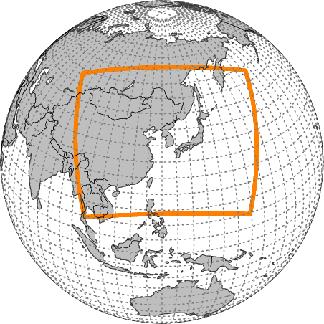
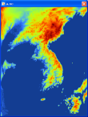
Operational NWP Models
Global
Resolution
N512L70(UM)
(~25km / top = 80km)
Target Length
288hrs (00/12UTC)
87hrs (06/18UTC)
Initialization :
Hybrid 4DVAR
Global EPS
Resolution
N320L70(UM)
(~40km/ top =80km)
Target Length
288hrs
IC : GDAPS
# of Members : 24
Regional
Resolution
12kmL70(UM)
(0.11°x0.11° / top=80km)
Target Length
87hrs (6 hourly)
Initialization : 4DVAR
Local
Resolution
1.5kmL70(UM)
(744×928 / top =39km)
Target Length
36hrs
Initialization : 3DVAR
Notes:
기상청의 현업모델은 주된 현업 모델은 전구, 지역, 국지, 전구 앙상블이다. 모두 UM 모델을 기반으로 하고 있는데, 전구는 중위도에서 25km 해상도에 70개 연직층을 가진다.
예측시간은 11. 12UTC는 288시간, 나머지는 87시간이다. 지역모델은 동북아시아를 예측범위로 한다. 해상도는 12km, 연직층은 70개이다. 일 4회, 예측시간은 87시간이다.
국지모델은 고해상도 모델로, 1.5km 해상도이다. 한반도 주변의 단시간 예측에 사용한다. 앙상블모델은 중위도에서 40km 해상도이고, 24개 맴버로 이루어져 있다. 초기상태는
전구모델에서 획득한다. 위성자료는 주로 전구와 지역모델에서 쓴다.
* 국지모델은 해상풍만 사용)

Slide 26
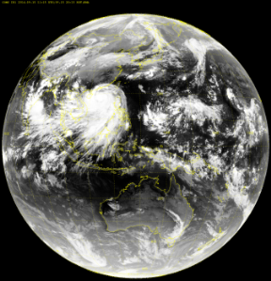
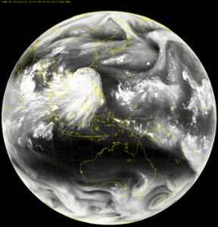
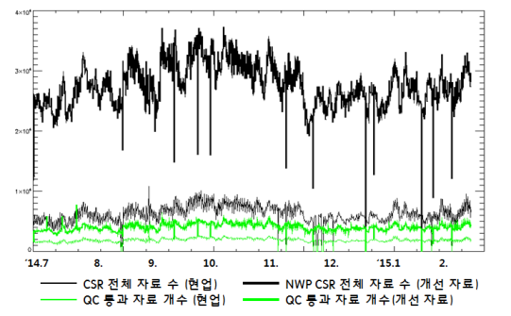
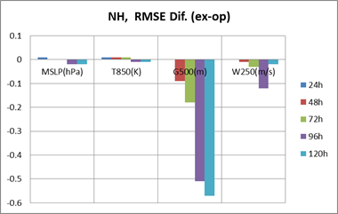
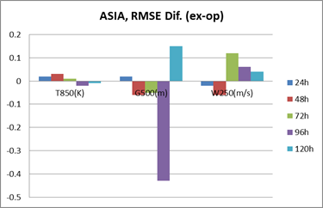
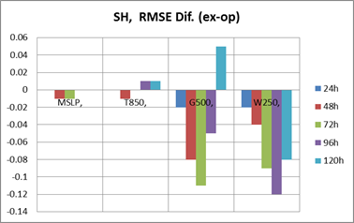
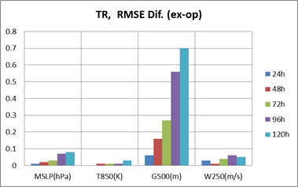
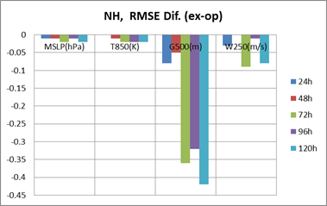
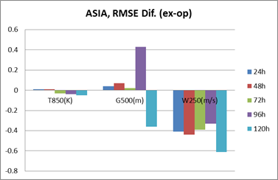
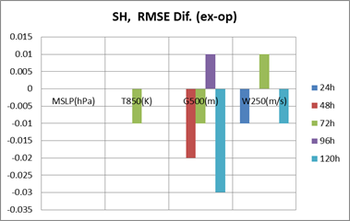
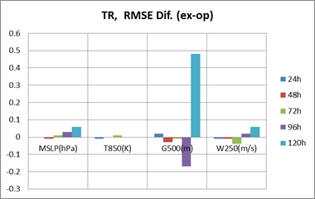
Changes in Data Assimilation
Introducing WV channel optimized Clear Sky Radiance (COMS)
  Using newly developed cloud mask which only removes highly developing cloud
  Advantages
    The numbers of data are increased (4 times for input and 2 times for QC passed)
    Slightly positive impact on 500 hPa geopotential height and high level wind
COMS IR Image
COMS WV Image
NH
ASIA
SH
TR
Negative
Jan
2015
Positive
Jul
2013
Notes:
기상청은 위성자료 활용 확대를 위해 몇 가지 실험을 하고 있다.
첫번째는 수증기채널을 최적화한 천리안 CSR 자료 실험이다.기존에 쓰던 구름 마스크를 새로 개발하여 수증기 채널에서 하층운이 있는 영역도 쓸 수 있도록 하였다.
그 결과 관측자료는 4배, 품질검사를 통과한 자료의 양이 2배가 되었다.
또한 500hPa 지위고도와 상층풍 예측에 전체적으로 긍정적인 영향을 주는 것으로 나타났다.
도표는 RSME를 실험에서 현업을 뺀 것으로 음의 값이 향상된 것을 뜻한다.

Slide 27
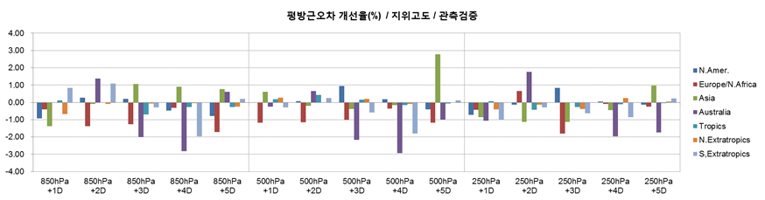
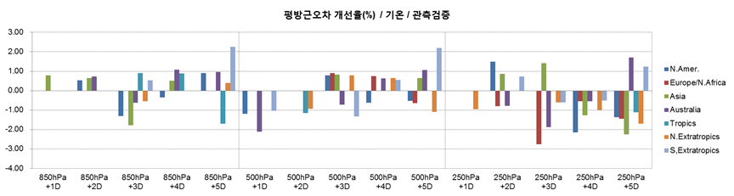
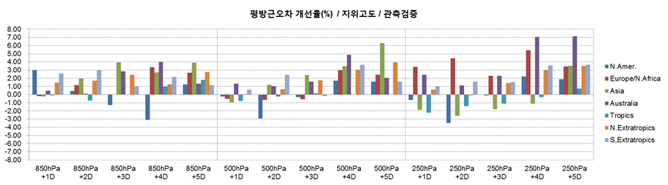
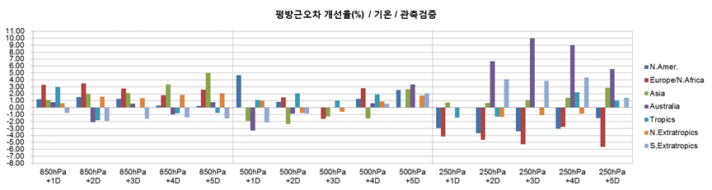
Changes in Data Assimilation
Positive
Negative
Jul
2013
Jan
2015

Slide 28
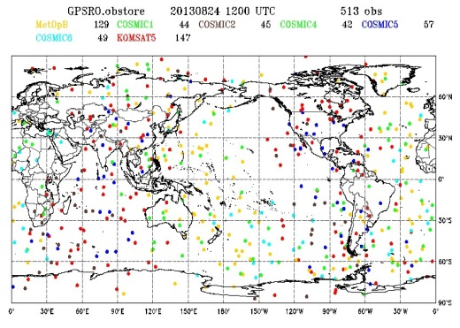




Changes in Data Assimilation
Additional GNSS Radio Occultation(KOMPSAT-5/Metop-A)
  KMA has been attempting to assimilate KOMPSAT-5 RO data into global model.
  Metop-A data will be added in global DA. 36% obs # increased, 1.3% 500hPa RMSE decreased.
Additional use of direct readout IASI data (Metop-A/B)
  Operational use in KMA global system since Jun. 2015
  Increased use of the data (Blue color represents the direct readout IASI data)
30% obs # increased of RO data
KOMPSAT-5 horizontal distribution
36% obs # increased of RO data
KOMPSAT-5
MetOp A
Examples of additional coverage(blue : local IASI, orange: global IASI)
Notes:
두 번째는 GNSS RO 자료 활용 확대이다. KOMPSAT-5 위성과 METOP-A 위성의 GNSSS RO 관측자료를 전구모델에 입력하는 것으로,
관측자료 증가량은 KOMPSAT-5가 약 30%, METOP-A가 약 36%이다. METOP-A 자료를 추가활용하는 경우, 500hPa 지위고도의RMSE가 1.3% 감소하는 효과가 있었다.
(KOMPSAT-5는 실험 중)
마지막으로 IASI 직수신 자료 활용이다. 이 부분은 2015년 6월부터 현업 전구모델에 적용되어 있다.
이를 통해 관측자료를 빠르게 확보할 수있게 되어 전구영역에서 약 3%, 아시아 영역에서 13~85% 증가하는 효과가 있었다.

Slide 29
Action Items Responds of KMA

Slide 30


N.4.7 All Centres to investigate putting soil temperature and moisture observations on the GTS. ACTION: All Centres
Response : KMA is not ready to put those data on the GTS yet due to the data quality validation.
Current Status
- soil temperature obs. : 74 sites of KMA
- soil moisture obs. : 11 sites of KMA
158 sites of RDA (Rural Development Administration)
Soil Moisture obs. sites
11 sites managed by KMA
158 sites managed by RDA

Slide 31


Soil moisture estimated by SMOS and AMSR2 is utilized internally in KMA
Currently, validation study is being carried out by comparing those data with ground observations

Slide 32


Action 2011-11-10 3.1 Wind Profiler Data: Bureau and KMA to investigate the availability of Australian and Korean wind profile data.
May 2014 Update: KMA have 8 profilers. Data is being input to NWP systems. Limited GTS bandwidth is an issue so some work is required within KMA.
Response : The validated wind profilers data can be available on GTS if GTS bandwidth issue would be solved.
Current Status
KMA is running 12 wind profilers and 4 of them is being used for data assimilation
KMA is carrying out the process for augmentation of GTS bandwidth up to 4Mbps
with RMDCN which is linked to Japan and China

Slide 33
Action: General 2.x – All Centers need to provide an operational exchange of radar data. APSDEU/NAEDEX members will investigate the current availability and the possibility in providing data via GTS. Requirements of the data need to be communicated across organizations.
Lead: All APSDEU/NAEDEX Members
The variety of data format and the capacity of GTS bandwidth are the issue for sharing the radar data
- KMA is using UF as data format of radar
- KMA is sharing 2-D image data of radar observation with JMA and CMA, respectively

Slide 34
Action General 6.x – All Centers to ensure registration of their HRPT stations for protection from frequency allocation in the 1695-1710 MHz band. Also consider registration of their X-band reception stations.
Lead: all
KMA will join this acitivities
More information on site registration is needed
APSDEU_2012_GENERAL Investigate where on the GTS circuits the METOP datasets are getting blocked for the Asian region
ACTION: CMA, KMA, JMA, BoM, EUMETSAT, Met Office
No related issue raised by KMA Information Communication Team

Slide 35



Thank you

Slide 36
KOMPSAT-5
Launch : March 26nd 2015
Sun-Synchronous Dawn-Dusk Orbit
  528 km mean altitude and 97 deg. inclination
  10:50 AM MLTAN (Mean Local Time of Ascending Node)
  28 days repeat ground track
Ground Segment
KARI site in Daejeon
CURRENT LEO SATELLITES
Payload | Characteristics
AEISS-A | Advanced Earth Imaging Sensor System-A
IIP | Infrared Imaging Payload
Notes:
This slide is for the introduction of the KOMPSAT program.
The KOMPSAT (KOrean Multi-Purpose SATellite) program is a government funded space program and the 1st program was started in the mid 90’s.
The main mission of KOMPSAT-5 is the acquisition of independent high resolution SAR images,
And the secondary mission of the KOMPSAT-5 is the Atmosphere Occultation and Precision Orbit Determination named AOPOD which includes a dual frequency GPS receiver and a laser retro reflector Array (LRRA).
KOMPSAT-5 was launched in August 2013 and data will be open in near future
survey of natural resources, Surveillance of large scale disasters and its countermeasure by using a Synthetic Aperture Radar (SAR). KARI (Korea Aerospace Research Institute) is a primary contractor of KOMPSAT-5 development and SAR Payload operation.
KASI (Korea Astronomy and Space Science Institute) is in charge of the development of Atmosphere Occultation and Precision Orbit Determination (AOPOD) secondary payload which includes a dual frequency GPS receiver and a laser retro reflector Array (LRRA).

Slide 37

GK-2A Data Service Plan : Via Landline (DCPC-NMSC)
NMSC accomplished the construction of DCPC- NMSC and started normal operation on 29th March 2013 for providing COMS MI data as below list
- All five channels of COMS level 1B in binary and graphic file format
- 10 level 2 products in binary and graphic file format
(1) Cloud detection
(2) Land surface temperature
(3) Total precipitable water
(4) Cloud analysis
(cloud top temperature/pressure/height,
cloud type, cloud amount, cloud phase,
cloud optical thickness)
(5) Fog
(6) Rainfall Intensity
(7) Atmospheric motion vector
(8) Sea surface temperature
(9) Sea ice/snow cover detection
(10) Outgoing longwave radiance
http://dcpc.nmsc.kma.go.kr
The 5th Asia/Oceania Meteorological Satellite Users’ Conference

